Slide 1
Legal Operations for In-House Legal Departments
What is Legal Operations?

Slide 2
What is Legal Operations?
“a set of business processes, activities, and the professionals that enable legal departments to serve their clients more effectively by applying business and technical practices to the delivery of legal services. Legal ops provides the strategic planning, financial management, project management, and technology expertise that enables legal professionals to focus on providing legal advice.
The multidisciplinary line-up of the legal ops team includes experts in such fields as finance, marketing, data analytics, learning and development, and engineering. These professionals work with management to identify strategic investments that build capacity for the organization. Their capabilities help legal organizations to more effectively manage risks, monitor compliance, adopt the right technologies, and deliver value to the enterprise by accelerating the business. A proactive legal ops team can anticipate and plan for challenges before they arrive. ”
- 2020 Corporate Legal Operations Consortium

Slide 3
What is Legal Operations?
“a set of business processes, activities, and the professionals that enable legal departments to serve their clients more effectively by applying business and technical practices to the delivery of legal services. Legal ops provides the strategic planning, financial management, project management, and technology expertise that enables legal professionals to focus on providing legal advice.
The multidisciplinary line-up of the legal ops team includes experts in such fields as finance, marketing, data analytics, learning and development, and engineering. These professionals work with management to identify strategic investments that build capacity for the organization. Their capabilities help legal organizations to more effectively manage risks, monitor compliance, adopt the right technologies, and deliver value to the enterprise by accelerating the business. A proactive legal ops team can anticipate and plan for challenges before they arrive. ”
- 2020 Corporate Legal Operations Consortium
Notes:
Analogy – doctor’s offices, medical practices; lawyers and doctors have a lot in common, extra years of education, practical exams to qualify, years of experience in very focused areas – they’re truly EXPERTS in their field, and neither of their fields include “business or technical practices”
So you normally won’t ask a doctor to help run a medical practice or hospital – you look for someone with strategic planning, financial management, project management, technology expertise, and so on.
Why do you do that? So that the doctors and nurses can focus on providing expert level care AND so that they can have the resources and support they need to do that most effectively.
If that’s best practice for medicine management, shouldn’t something similar be best practice for legal services delivery?

Slide 4
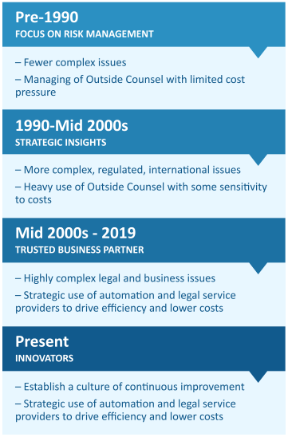
Where Did Legal Operations Start?
- 2020 Corporate Legal Operations Consortium
Notes:
Legal ops has been around for almost 30 years, but you may have just now begun to hear about it.
At the start, it wasn’t a dedicated position or even called out as a role – more than likely, it was a lawyer on in-house teams that was tasked with managing outside counsel. The extent of that was usually keeping a list of who was used for the most visible cases and sometimes reporting around how much was spent on those cases. Law firms may call those “the good ole days” when there wasn’t much cost pressure and law firms were chosen based solely on relationships.
Then up until around 2010, it was much the same but the breadth increased with the increase in international issues and heavy reliance on outside counsel to help keep up; costs were still mostly monitored on a high visibility basis and sometimes paralegals or exec admins were carrying some of the legal ops burden. Every once in a while, you’d hear the buzz words Legal Ops and some companies were converting some internal roles to legal ops or adding that responsibility on – not many really had a good grasp on what it meant yet. This is around the time that I joined NCR as their Director of Legal Operations. There was no handbook, no one to train me, and no rules to go by - other than “don’t piss off the lawyers”.
Then, over the past 10 years, legal ops has taken off – while the world and especially technology has evolved, so have the laws and business issues. Law firms were needed more and more, but the costs were becoming higher and higher, so the market became competitive and legal services providers came on scene. To help cope or even take advantage of all of the opportunities in the market, Legal operations teams became the next big thing and companies who caught on started establishing legal operations roles. That’s how I came to Ferring – as their very first legal operations person and now I’m growing my team – that’s how quickly the need was demonstrated and the value was discovered.
Even before COVID, companies found themselves in increasingly competitive markets where a major differentiator was innovation and the ability to be flexible. With both of those comes a demand on the legal services and has been one of the key drivers in bringing the General Counsel to the Exec table, or giving the GC a more prominent role at that table. And with that, comes an absolute need to be more strategic, to be a leader in controlling and anticipating costs – as you all know, a major litigation could seriously hamstring a company, but at the same time deeply intuitive legal advice could be a game-changer in an innovative company.
So that brings us to the Present day – legal operations as innovators in a culture of continuous improvement. That’s my day to day life – I’m constantly thinking to myself “is this the best way to do this?” and sometimes I’m thinking that about something I had a hand in designing just a few months prior!

Slide 5
Value Drivers in Legal Ops
Cross Functional Management
Data Analytics
Resource Optimization
Technology
Notes:
Strategically align with other functions and business partners for improved collaboration and driving impact
Use quantitatively and qualitatively data to identify opportunities to improve the function of the legal department
Maximize efficiency by using collaboration tools, workflow automation, Business Intelligence, and other solutions
Improve use of resources by matching the right work with the right provider

Slide 6
Value at What Cost or Benefit?
$530K
Potential internal annual cost impact
Notes:
That’s the net REDUCTION in compensation costs! Via work reallocation. This number was from a company called HBR Consulting and based on their research in 2018, along with a survey of law departments. They got to this by looking at hours worked and contributions from one legal operations person, based on median department size of 30 lawyers and 26 other staff.
I’ve seen several figures like this quoted – sometimes up to $1M

Slide 7
Are we Ready For Legal Operations?
In a recent legal department survey of primarily European teams, over half the respondents shared that their legal spend has increased in the last 12 months and a third have said that it stayed the same. Legal spend isn’t going away and is likely going to become more and more significant.
In the same survey, an average 50% of the same companies said that they outsource because of “Not Enough Internal Resources”.
When it comes to service issues that these teams encounter from their law firms, most are related to costs. They cited “Poor price performance ratio”, “non-adherence to agreed caps / fixed fees”, and “Non-adherence to agreed billing guidelines” as the most common complaints.
Unsurprisingly, less than 50% currently use legal technology that can assist in these areas, but what’s really great to see is that 74% expect to increase their legal technology budget in the next 12 months.
Source: Busylamp Legal Operations Benchmarking Report 2019
Notes:
These are some of the key areas that a legal operations function can not only help with, but make a high impact in, and capture that added value.

Slide 8
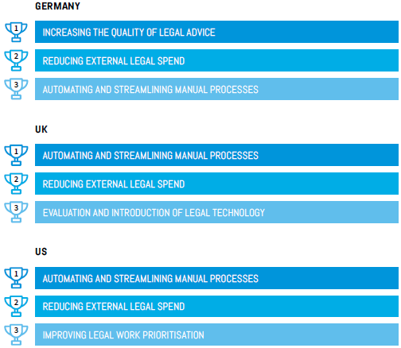
What Are Your Top Priorities?
Source: Busylamp Legal Operations Benchmarking Report 2019
Notes:
Okay, so you’ve either learned a lot more about legal operations so far today, or you’ve solidified what you already knew.
In either case, one of the most important things an organization must do to enable or enhance a legal operations strategy is to define – and keep defining – the priorities of the legal team.
In a recent survey of top priorities, 2 pertinent items showed up on every respondent’s list:
Reducing external spend
Automation
two things that are fairly difficult to manage without dedicated personnel or a strategy around it
Coming in quickly behind those two is the need to optimize the legal services received and given.
This is one of my favorite areas of legal operations – optimizing the talent – both internal and external and this is where those of you who are NOT inhouse counsel can really differentiate yourself

Slide 9
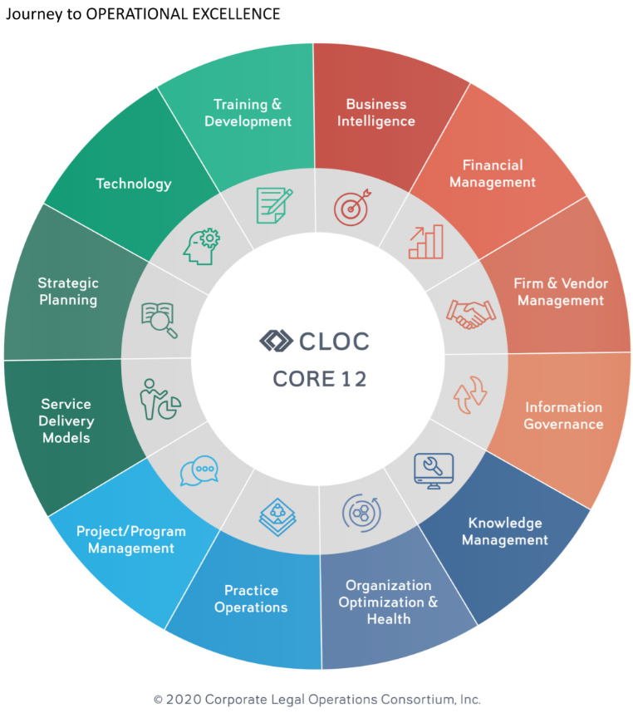
So How Can Legal Ops Help?
A good Legal Ops function can help in a myriad of ways – which ways they do is up to you!

Slide 10
The Legal Ops Professional
Legal Ops professionals tend to come from operational and / or finance backgrounds.
The skill set is shifting from former lawyers and legal assistants to accounting or finance managers or specialists, CFOs, COOs, and the like.
A colleague of mine recently said in an interview about the state of their Legal Ops position,
“It has been completely overhauled from reactive to strategic; now we offer rich analysis and identify how analytics are impacting resource allocation, staffing, pricing and hiring.”
In addition to the diversity of work, operations leaders are developing an increased level of technology-related expertise.
“It has become a lot more technical; like a moth to light, I am drawn to technology,” said a legal operations director in the Energy sector. “
Notes:
Key is hiring someone with a diverse skill set that matches your priorities, and the absolutely necessary ability to actively learn. No two days are the same in the Legal Ops world!
Tell about the presentation done for Wolters Kluwer
This is important for our vendors to know as well – whether you’re a law firm, an alternative service provider, or a legal technology provider – this is a key piece of knowing your customer

Slide 11
We Haven’t Forgotten About Law Firms
Chief of Staff
Greater need to partner
Act like a business too, not a profit center
Know that cybersecurity and globalization / centralization is coming your way
Anticipate staffing challenges
Become an ALSP
Notes:
I’ve mentioned law firms and other partners here and there when describing the legal ops journey, but I want to put a finer point on the importance of them in the relationship and evolution….
The most common area to cut costs was with non-law firm vendor spending. The number of CLOs who reported that they’d reduced vendor spending doubled year-over-year to 18%. Looking ahead, 25% of CLOs planned to cut vendor spending next year.
“To me, nothing focuses the attention on the most critical issues more than a crisis does. Some of the vendor spend is going to be a little less mission critical than paying outside counsel, for example,” Wilber said.
While revenues are down and budgets are tighter, legal departments are still being asked to do more with less—77% of the CLOs in the study said their workloads had increased and 25% reported that their workload had increased significantly.
Other noteworthy findings from the study include:
77% of CLOs expect that remote or flexible working arrangements implemented during the pandemic will become permanent for legal department lawyers and staff.
33% of law departments asked for additional discounts from law firms this year, when the median discount on standard hourly billing rates was 10%.
CLOs spent 15% of their time this past year addressing COVID-related issues.

Slide 12
Legal Operations for In-House Legal Departments
Questions? email: Sheila.Dusseau@ferring.com

